Slide 1
BLOG WITH
API
Yaiser Ávila - Paúl Molano

Slide 2
01
DAILY LOG
Record of significant occurrences, incidents, and progress made

Slide 3
DAILY LOG
Day 1
Day2
Day3
Day4
Day5
Research
& Dev design
HTML, bootstrap and post drawing (get_api)
Modal drawing and get api with multiple sources
Modal edition and deletion with patch and delete api request implemented
Presentation

Slide 4
02
TECHNOLOGIES
What technologies are been used in this project.

Slide 5
TECHNOLOGIES
01
02
03
Bootstrap
Postman and API request
Async functions, axios, callbacks and promises

Slide 6
03
LESSONS LEARNED
What lessons we’ve learned during this project

Slide 7
LESSONS LEARNED
01
02
03
BOOTSTRAP
AXIOS
ASYNCHRONOUS PETITIONS

Slide 8
LESSONS LEARNED
04
05
06
RESEARCH
JSON SERVER
TEAM ORGANIZATION

Slide 9
04
PROBLEMS
ENCOUNTERED
What problems have we encountered when developing this project

Slide 10
PROBLEMS ENCOUNTERED
01
02
03
Bootstrap customization
Loading the localhost
Fetch Vs. promises and scope

Slide 11
05
SCREENSHOTS
More important blog screenshots

Slide 12

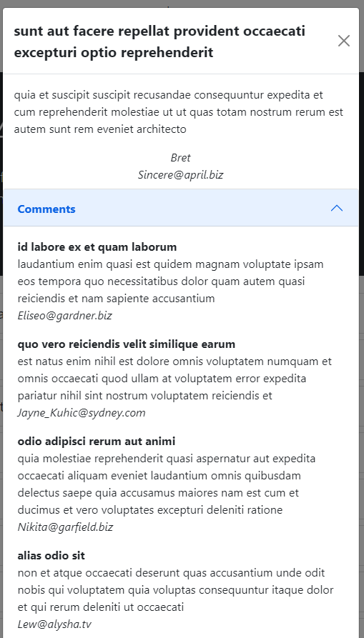
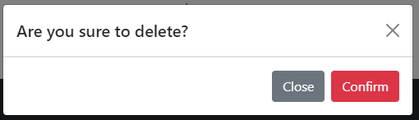
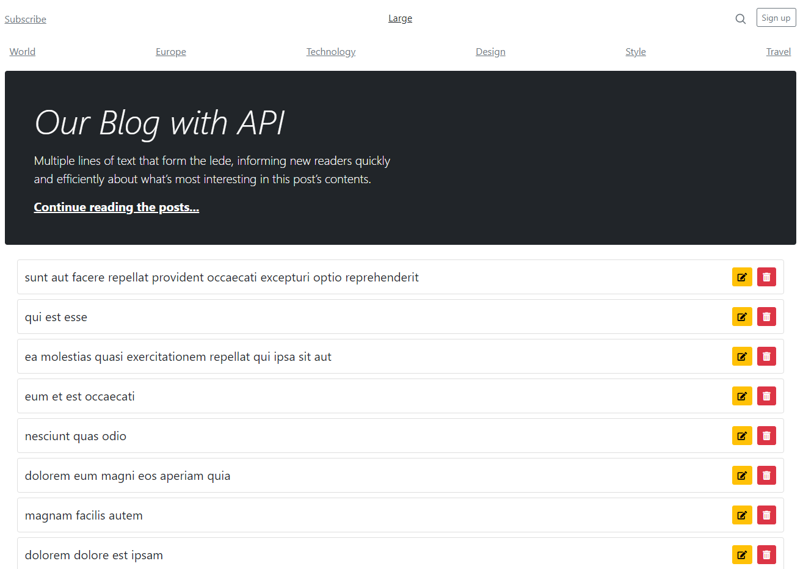
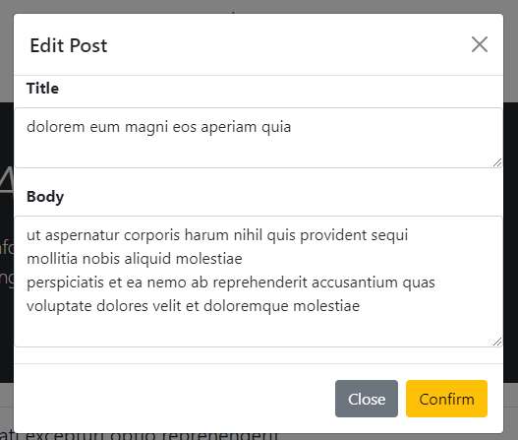
A PICTURE IS WORTH A THOUSAND WORDS

Slide 13

THANKS!
Please keep this slide for attribution.

